Slide 1
Creating Task From Scratch
Brandon Minnick
Code Traveler, LLC
Notes:
Welcome to the last lecture of Day 1. This morning we watched the compiler rewrite an async method into a state machine and saw the thread change underneath GetLibraries(), then we fixed the HackerNews app. Since lunch we have been inside the runtime: [ThreadStatic], AsyncLocal<T>, ExecutionContext, Principal and SynchronizationContext, and you just spent the last hour watching ambient values flow, or not flow, across an await.
Now we put all of it to work. Over the next twenty minutes you will meet every building block a Task is made of: a work queue, a completion flag, a list of callbacks, a lock, a way to store an exception, a blocking wait, a timer, and the small pattern the compiler looks for when it sees the await keyword. Then you open a CustomTask class whose members are only stubs and fill them in yourself.
Two files are already written for you in the starter project. CustomTaskAwaiter.cs is complete: it is the bridge between await and your class, and we read it together near the end of this deck. Program.cs is also complete: it calls every public member of CustomTask, and the starter still compiles because CustomTask.cs declares each of those members as a stub that throws NotImplementedException. Run it, and each exception message is a hint about what that member needs to do. The stubs are the challenge's to-do list.
Nothing on these slides is finished solution code. Each slide shows one .NET primitive and explains how it fits. Assembling them is your job, and that is the fun part. After the challenge we compare approaches and walk through SOLUTION.md together.
References:
https://github.com/dotnet/runtime/blob/main/src/libraries/System.Private.CoreLib/src/System/Threading/Tasks/Task.cs

Slide 2
A Task Is Not a Thread
A Promise That Tracks Completion
Notes:
Say this out loud before writing any code: a Task is not a thread. It does not run anything. It is a promise, a small object that tracks whether a piece of work has finished, what the outcome was, and who is waiting to hear about it.
When you call Task.Run(), the Thread Pool does the running. The Task you get back only records the result when that work finishes. Task.Delay() uses no thread at all while it waits; a timer fires and completes the Task. And when you await, nothing about the Task changes. You are asking the Task to call you back when it completes.
This is the mental model that makes the challenge feel small. Once you separate the work from the object that tracks the work, every method you need to write becomes obvious: something marks the task complete, and something registers who wants to know.
Why this matters for the challenge: Program.cs prints the Starting Thread Id and then a thread Id from inside each CustomTask. Those three Ids come from Thread Pool threads, never from the CustomTask object itself. If your design ever needs the CustomTask to "be" a thread, come back to this slide.
References:
https://learn.microsoft.com/dotnet/standard/parallel-programming/task-based-asynchronous-programming

Slide 3
Task
Three Pieces of State
Completion state
  Finished or not, set exactly once, read from any thread
Outcome
  A result, or the stored `Exception`
Continuations
  Who to call back when it completes
`Task.Run()` queues the work; the `Task` only records what happened
Notes:
Here is everything a Task actually holds.
Bullet by bullet:
• Completion state: a flag that starts false and becomes true exactly once. IsCompleted exposes it. It is read from many threads at once, one awaiting and one completing, so reading it and writing it go through the same lock.
• Outcome: either nothing (a plain Task), a result (Task<T>), or a stored Exception. Never a result and an exception at the same time. Our CustomTask carries no result value, so its outcome is simply "did it throw, and what".
• Continuations: the callbacks to invoke when the flag flips. Plural. The next few slides are almost entirely about this list.
• Task.Run() queues the work; the Task only records what happened: a good example of how thin the wrapper is. Task.Run() creates a Task, hands your delegate to the Thread Pool, and when the delegate returns it marks the Task complete. If the delegate throws, it stores the exception instead. Nothing more.
The real Task in dotnet/runtime is thousands of lines because it also handles cancellation, schedulers, child tasks, results and a very clever lock-free continuation field, but the shape underneath is exactly these three things.
Why this matters for the challenge: requirement 1 (track completion state safely across threads) and requirement 2 (store exceptions) are the first two pieces on this slide, and the list of continuations is requirement 5. Decide on your fields before you write a single method.
References:
https://github.com/dotnet/runtime/blob/main/src/libraries/System.Private.CoreLib/src/System/Threading/Tasks/Task.cs

Slide 4
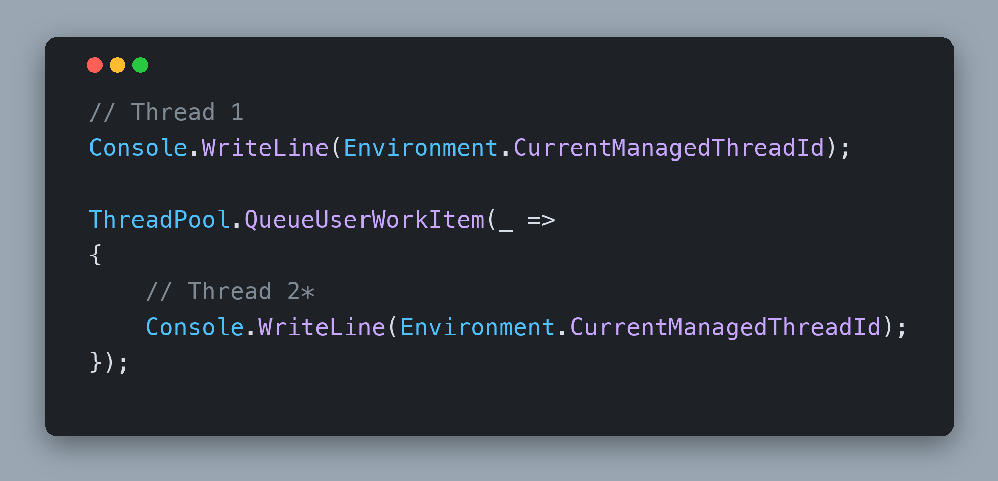
Thread Pool
ThreadPool.QueueUserWorkItem()
Hands a delegate to a pool thread, returns immediately
The primitive underneath `Task.Run()`
Captures the caller's `ExecutionContext`
ThreadPool.UnsafeQueueUserWorkItem does not
Notes:
ThreadPool.QueueUserWorkItem() is the primitive behind Task.Run(). You hand it a delegate, and one of the pool's worker threads picks it up as soon as one is free. The caller does not wait.
Bullet by bullet:
• Hands a delegate to a pool thread, returns immediately: run this snippet and the two thread Ids differ. Remember Thread 1 and Thread 2 from this morning's GetLibraries() animation? Same idea, same footnote: it can be any thread other than Thread 1, and it can be a different number every run.
• The primitive underneath Task.Run(): Task.Run() creates a Task, queues a work item that invokes your delegate, and completes the Task when the delegate returns. That is the shape of your Run(Action) too: create, queue, complete. Wrap the delegate in try/catch so an exception completes the task instead of crashing the pool thread; the Exceptions slide covers what to do with it.
• Captures the caller's ExecutionContext: QueueUserWorkItem() snapshots the calling thread's ExecutionContext and restores it on the pool thread before your delegate runs, exactly the Capture() and Run() pair from the .NET Internals deck. UnsafeQueueUserWorkItem() skips that capture. For Run() itself the plain version is what you want, because the caller's ambient state (culture, principal, AsyncLocal values) should flow into the work, just like the real Task.Run(). Hold on to the Unsafe variant; it comes back on the ExecutionContext slide.
Why this matters for the challenge: requirement 3 is Run(Action) on the Thread Pool, and acceptance check 2 runs Step 1 of Program.cs, where the Run() action prints a thread pool Thread Id instead of the main thread's: the visible proof that the work left the starting thread.
References:
https://learn.microsoft.com/dotnet/api/system.threading.threadpool.queueuserworkitem
https://github.com/dotnet/runtime/blob/main/src/libraries/System.Private.CoreLib/src/System/Threading/ThreadPoolWorkQueue.cs

Slide 5
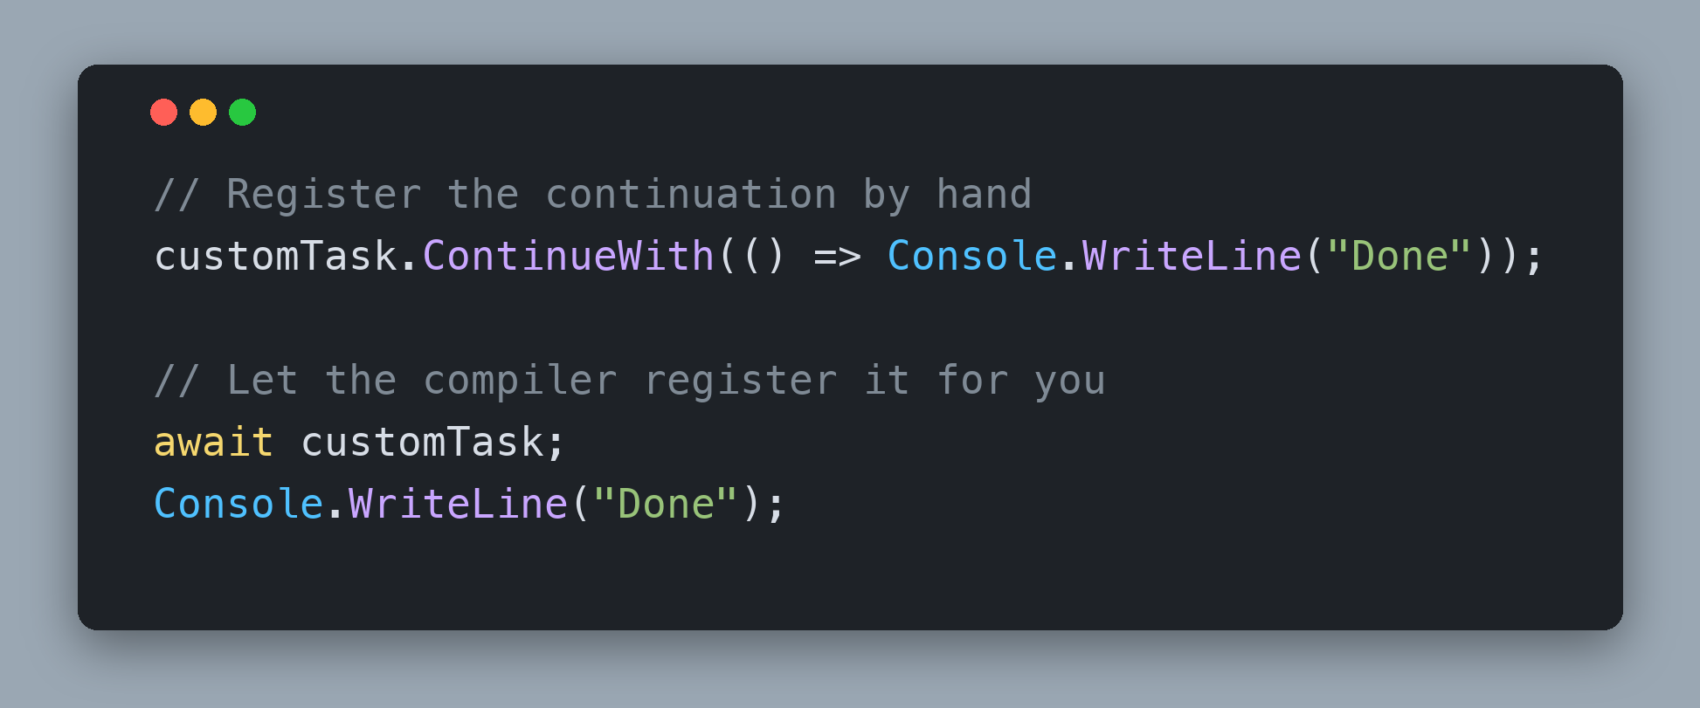
Continuations
The Rest of Your Method
Code that runs when a `Task` completes
Every `await` registers one; so does `ContinueWith()`
Already complete? Run it now. Not yet? Store it
One `Task` can have many
Notes:
A continuation is how work resumes. Think back to this morning: GetLibraries() started on Thread 1, hit an await, and the rest of it came back on Thread 2, or Thread 5, or Thread 17. The code after the await did not run by magic. The compiler registered it as a continuation on the Task, and the Task invoked it when it completed.
Bullet by bullet:
• Code that runs when a Task completes: that is the whole definition. A continuation is a delegate the Task promises to call later.
• Every await registers one; so does ContinueWith(): the two halves of the snippet do the same thing. The top half registers the callback by hand. The bottom half lets the compiler register the rest of the method for you. Your ContinueWith() takes a plain Action, with no parameter; the real Task.ContinueWith() hands the antecedent to the delegate, which you do not need here. The Runtime Async slides this morning said it in one sentence: a continuation is the rest of the method after an await, and something has to remember it.
• Already complete? Run it now. Not yet? Store it: registration has two paths. If the Task has already finished there is nothing to wait for, so schedule the callback immediately. If it has not, put it somewhere the completion code can find it. Deciding which path applies is a check-then-act step, and the next slide explains why it must be atomic.
• One Task can have many: two methods can await the same Task. One thread can call Wait() while another calls ContinueWith(). Each of those is its own continuation, which is the next slide.
Why this matters for the challenge: ContinueWith(Action) (requirement 4) returns a new CustomTask that represents the continuation itself, not the original task. That returned task is how chaining works, and it must complete when the continuation finishes: with the SetResult() method when the action returns and the SetException() method when it throws. Those two are yours to write, and the Completion slide in two slides' time defines them. Skip that and acceptance check 4, chaining ContinueWith() on the task ContinueWith() returned, waits forever.
References:
https://learn.microsoft.com/dotnet/api/system.threading.tasks.task.continuewith
https://github.com/dotnet/runtime/blob/main/src/libraries/System.Private.CoreLib/src/System/Threading/Tasks/TaskContinuation.cs

Slide 6
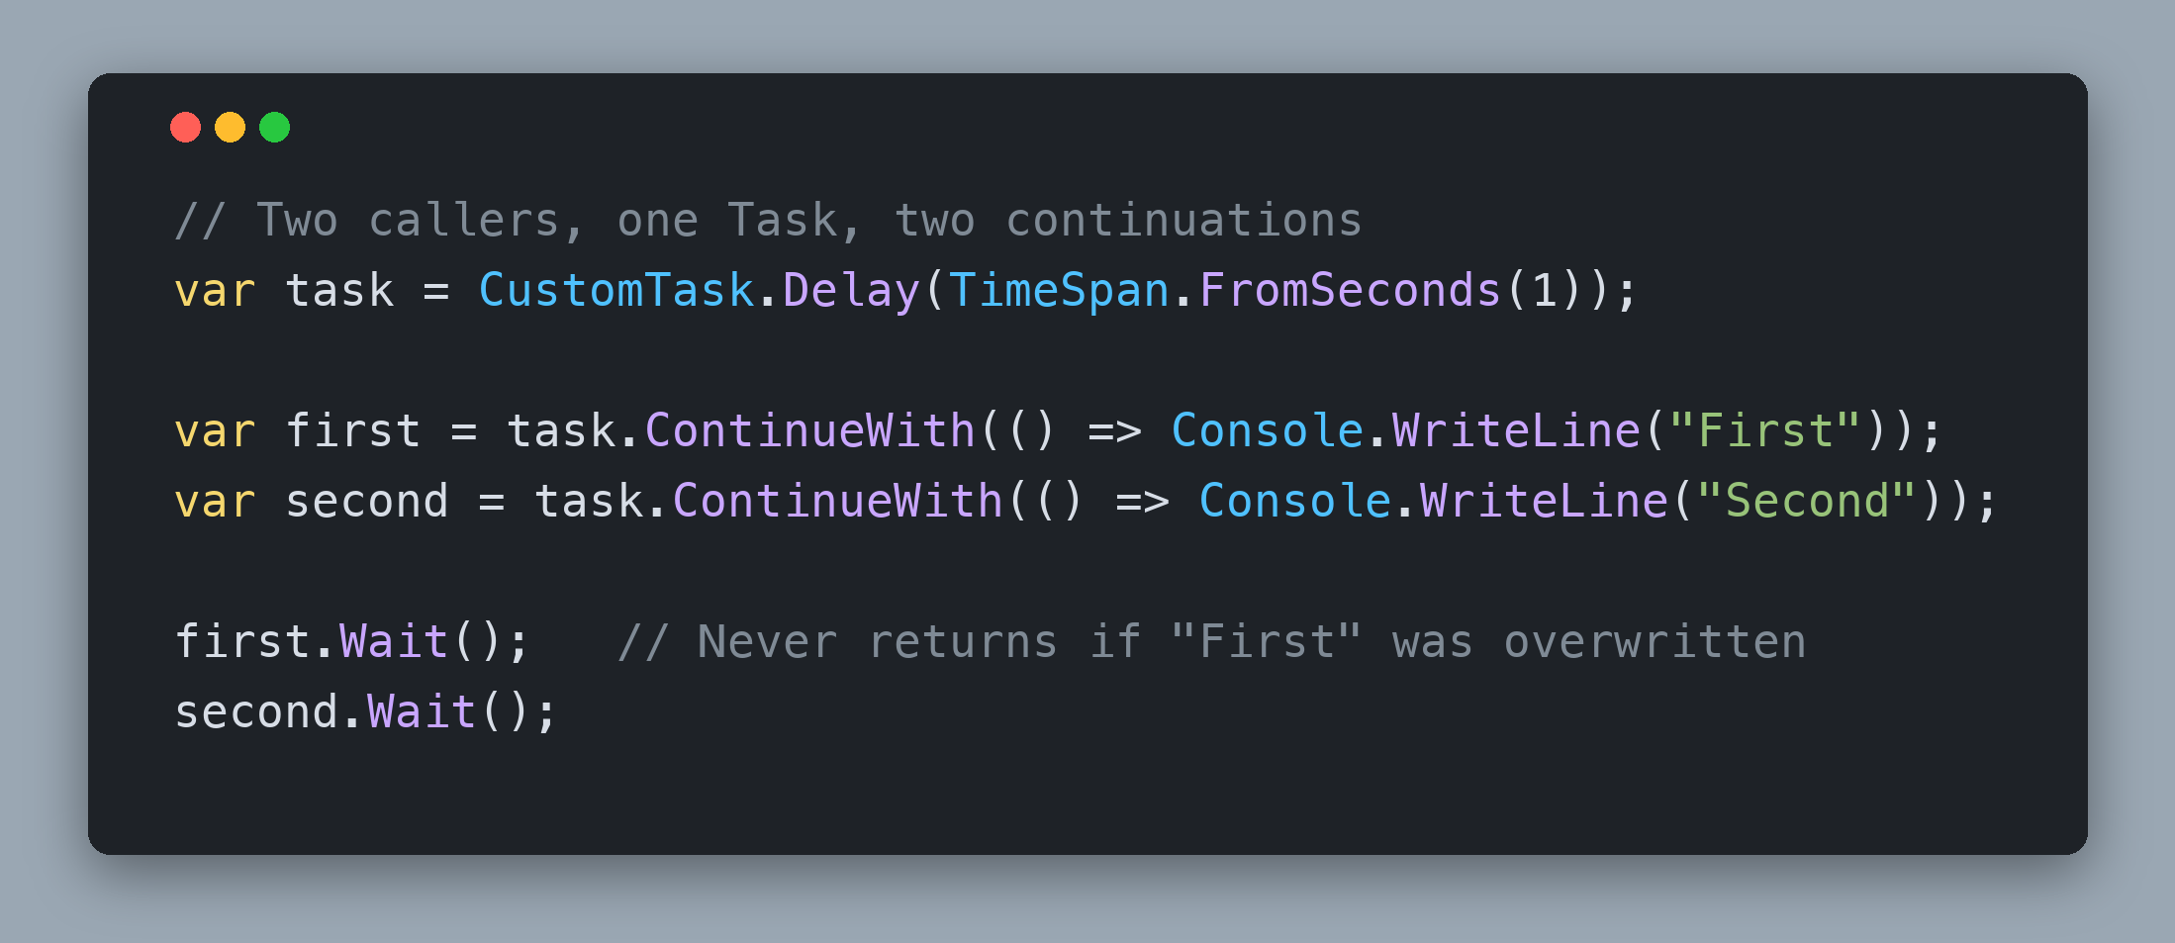
Continuations
One Task, Many Waiters
`await`, `ContinueWith()` and `Wait()` each register one
A single `Action` field keeps only the last one
Keep a list of Continuations
  Execute the continuations it when the `Task` completes
Notes:
Here is the bug almost everyone writes first.
Bullet by bullet:
• await, ContinueWith() and Wait() each register one: every one of those goes through the same door. Wait() registers a continuation that unblocks the waiting thread. await registers the rest of the method. ContinueWith() registers your delegate. Three callers, three continuations, one Task.
• A single Action field keeps only the last one: if you store the pending continuation in one field, every registration before completion overwrites the previous one. In the snippet, "First" is silently dropped, so the task ContinueWith() returned for it never completes, and first.Wait() blocks forever. Acceptance check 5, two callers waiting on the same incomplete CustomTask, catches exactly this.
• Keep a list; drain it when the Task completes: store every pending continuation, and on completion run all of them. The next slide covers how to drain it safely.
• Check-then-register must be atomic: ContinueWith() reads the completed flag and then either schedules or stores. If the Task completes between those two steps, the stored continuation is never run. The read and the write have to happen under one lock. A ConcurrentQueue<T> would make the add thread safe, but it cannot make check-then-add atomic, so a plain List<T> under the lock is the simpler, correct container. .NET 9 added System.Threading.Lock, a dedicated lock object that the lock statement understands; declare it once as a readonly field and use the ordinary statement. Tomorrow morning's Asynchronous vs Parallel deck goes deeper on Lock, Interlocked and SemaphoreSlim.
The real Task keeps its continuations in a single object field that is either null, one continuation, or a List<object>, swapped with Interlocked.CompareExchange and replaced by a sentinel on completion. Look for m_continuationObject in Task.cs. It avoids the lock, and it is far more complex than this workshop needs.
Why this matters for the challenge: requirement 5, multiple pending continuations, and requirement 1, completion state that is safe across threads, are the two halves of this slide. The snippet is also a test worth running. Add it to Program.cs temporarily while you work, and delete it before you compare with 2. Finish. Start from CustomTask.Delay() so the task is still pending when both continuations register.
References:
https://github.com/dotnet/runtime/blob/main/src/libraries/System.Private.CoreLib/src/System/Threading/Tasks/Task.cs
https://learn.microsoft.com/dotnet/api/system.threading.lock

Slide 7
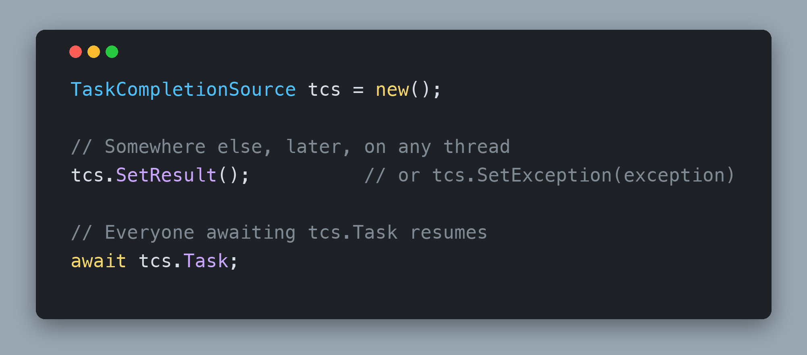
Completion
Complete Exactly Once
`SetResult()` or `SetException()`
  Never both
A second completion throws `InvalidOperationException`
Copy the list inside the `lock`, dispatch outside it
`TaskCompletionSource`: the same surface on a real `Task`
Notes:
Completion is the other side of registration: one method that flips the flag, stores the outcome and runs everything that was waiting.
Bullet by bullet:
• SetResult() or SetException(), never both: both public methods can share one private completion method that takes an optional exception. A null exception means success.
• A second completion throws InvalidOperationException: a Task completes once. TaskCompletionSource enforces the same rule: call SetResult() twice and the second call throws. Copy that behaviour; it turns a silent double-completion bug into a loud one.
• Copy the list inside the lock, dispatch outside it: take the lock, set the flag, store the exception, copy the pending continuations, clear the list, release the lock, then dispatch the copies. Keep the dispatch outside the lock so you are never holding it while other people's code runs; a continuation that calls back into this task would then run inside your critical section, and any lock a continuation takes becomes a second lock held at the same time, which is how lock-ordering deadlocks start. Because the flag is already true once the lock is released, any continuation registered while you are draining takes the run-now path and nothing is lost.
• TaskCompletionSource: the same surface on a real Task: when you need a Task for work that is not a Task, a callback API, an event, a timer, you create a TaskCompletionSource, hand out its Task, and call SetResult() or SetException() when the callback fires. Everyone awaiting tcs.Task resumes. That is exactly the surface you are building on CustomTask, and it is the API you reach for in production.
Why this matters for the challenge: requirements 1, 2, 5 and 11 all meet in this one method, and it is the method the next three slides keep pointing back to.
References:
https://learn.microsoft.com/dotnet/api/system.threading.tasks.taskcompletionsource
https://github.com/dotnet/runtime/blob/main/src/libraries/System.Private.CoreLib/src/System/Threading/Tasks/TaskCompletionSource.cs

Slide 8
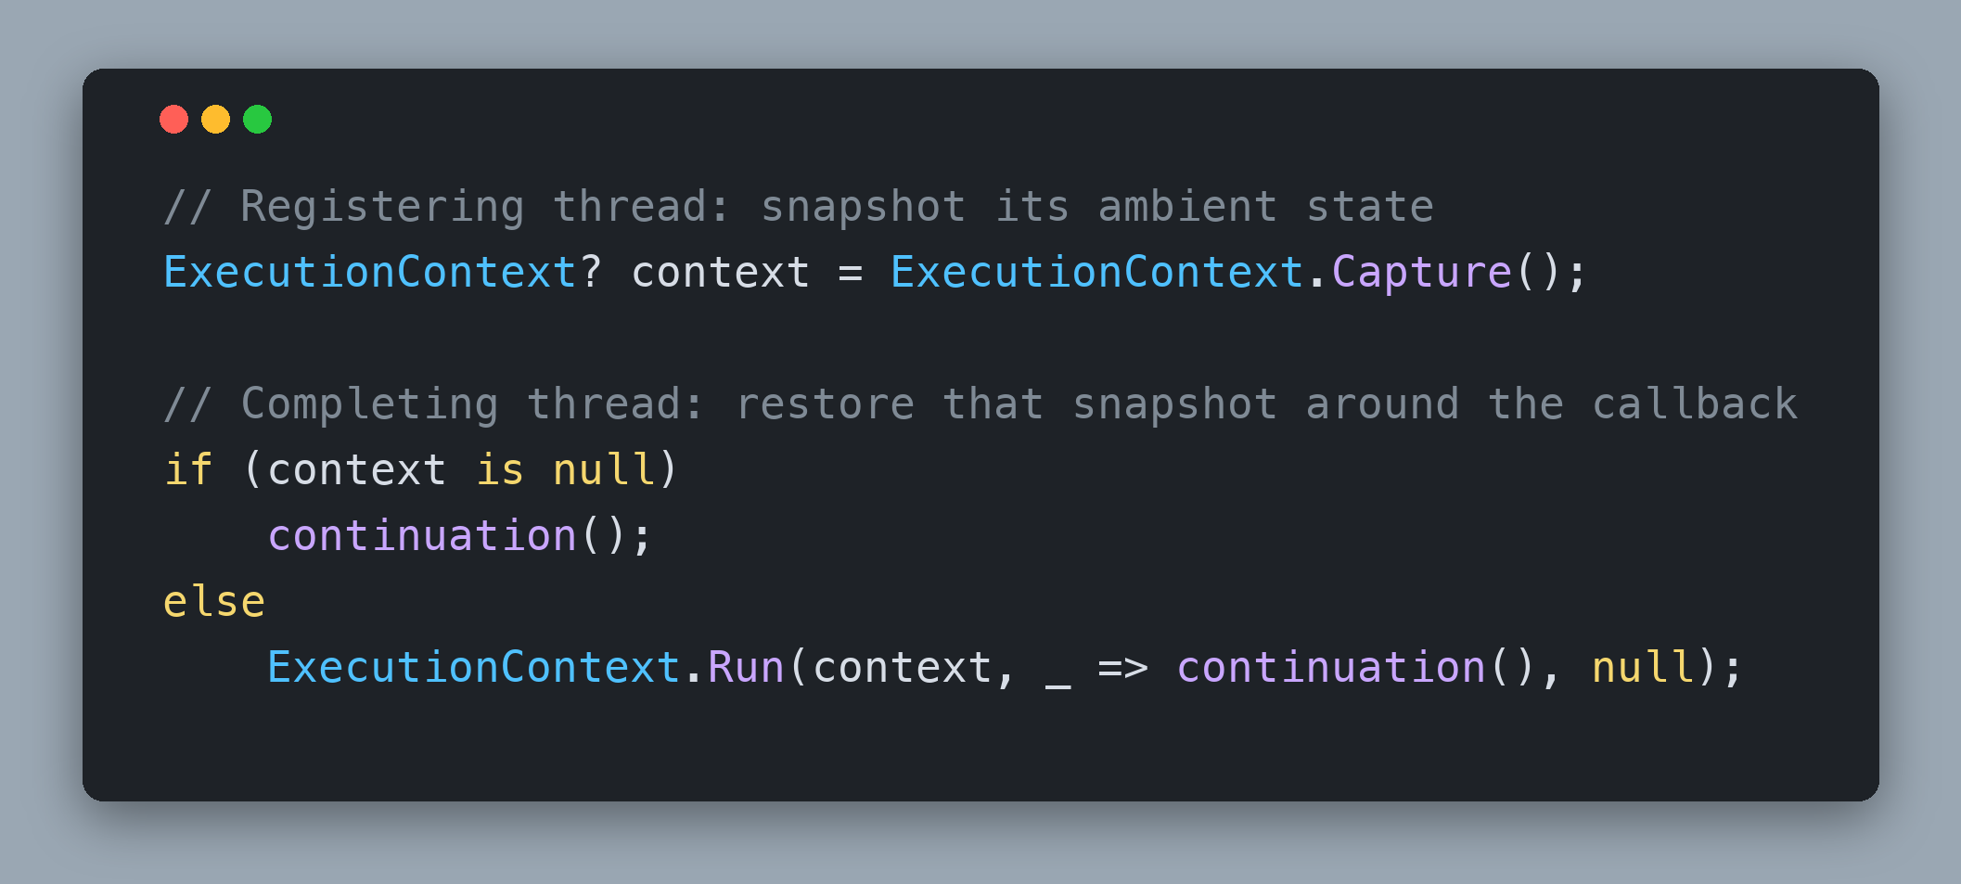
ExecutionContext
Capture() on Register, Run() on Dispatch
Capture when Task is registered
When Null, Run Continuation
Dispatch with `UnsafeQueueUserWorkItem()`
Notes:
This is the direct payoff of the last hour. In the ExecutionContext challenge you set a culture, a principal and an AsyncLocal value on the main thread, captured the context with ExecutionContext.Capture(), and ran a callback on a background thread with ExecutionContext.Run(). The background thread saw the main thread's values. Then you wrapped Task.Run() in SuppressFlow() and the values disappeared. Now you build the mechanism that made that happen, automatically, for every continuation.
Bullet by bullet:
• Same Capture() + Run() as the .NET Internals deck: Capture() takes a snapshot of the current thread's ambient state. Run(context, callback, state) restores that snapshot on whatever thread ends up running the callback, runs it, then puts the thread's previous context back.
• Capture on register: that caller's state is what matters. Two threads have a stake in every continuation, the one that registered it and the one that completed the task. Only the first one matters. The code after an await expects the ambient state it had before the await, not the culture or principal of whichever pool thread happened to finish the work. So call Capture() at the moment a continuation is registered, and store the snapshot next to the continuation so the two travel together.
• Null context: still queue it, just skip Run(): Capture() returns null when the registering thread had SuppressFlow() active. That is not an error, it is the caller asking for no ambient state to travel. The continuation is still queued like every other one, and the only difference is that you invoke the delegate without wrapping it in ExecutionContext.Run(), so it runs on the pool thread's default context.
• Dispatch with UnsafeQueueUserWorkItem(): ThreadPool.QueueUserWorkItem() silently captures the calling thread's ExecutionContext. Inside your completion method the calling thread is the completing thread, and its ambient state has nothing to do with anyone waiting. Using the plain version there would hand that state to every continuation whose own capture came back null, which is the async version of the [ThreadStatic] leak from after lunch, where a re-used thread carries one request's data into another. The Unsafe variant skips the capture, so the only context a continuation ever sees is the one its registrar captured, or none at all. The run-now path of ContinueWith() is different: there the calling thread is the registering thread, so plain QueueUserWorkItem() already captures the right context.
Why this matters for the challenge: requirement 6 is this slide word for word: preserve each caller's ExecutionContext when a continuation is registered before the antecedent completes, and never leak the completing thread's context into any continuation.
References:
https://github.com/dotnet/runtime/blob/main/src/libraries/System.Private.CoreLib/src/System/Threading/ExecutionContext.cs
https://learn.microsoft.com/dotnet/api/system.threading.threadpool.unsafequeueuserworkitem

Slide 9
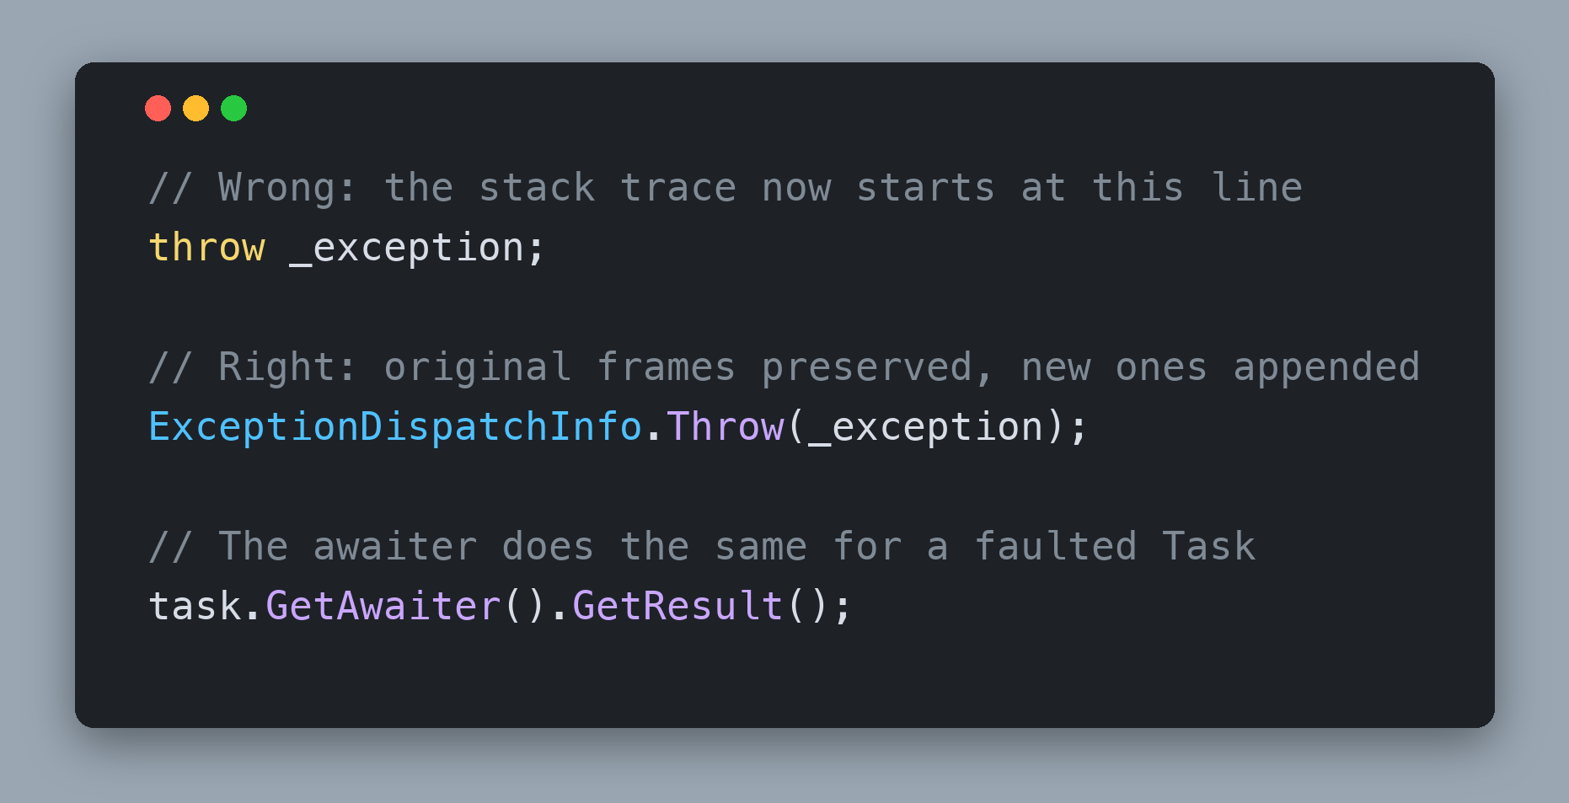
Exceptions
ExceptionDispatchInfo
Catch on the Thread Pool thread
  Store Exception in the `Task`
Rethrow on the thread that waits or awaits
Always use `ExceptionDispatchInfo` to preserve Stack Trace
  `throw ex;` resets the stack trace
Notes:
When the work inside Run() throws, you are on a pool thread and there is nobody above you to catch it. This morning's Await Every Task slide described what the real Task does: the builder catches the exception, calls SetException(), and the Task moves to Faulted carrying it. You are about to write that by hand.
Bullet by bullet:
• Catch on the pool thread, store on the Task: try/catch around the delegate, then complete the task with the exception instead of a result.
• Rethrow on the thread that waits or awaits: the exception surfaces later, on whichever thread calls Wait() or awaits the task, which is exactly where an exception from an async method surfaces today.
• throw ex; resets the stack trace: the trap is how you rethrow. Writing throw on the waiting thread rewrites the trace to that line, so the frames that pointed at the real bug are gone.
• ExceptionDispatchInfo preserves it: ExceptionDispatchInfo, in System.Runtime.ExceptionServices, exists for exactly this. Throw(exception) rethrows while keeping the captured trace and appends the new frames underneath. ExceptionDispatchInfo.Capture(exception).Throw() is the older two-step form and does the same thing. That using is already at the top of the starter CustomTask.cs, which is a hint.
TaskAwaiter.GetResult() uses this same machinery to rethrow the first exception of a faulted Task. It is why the Best Practices deck this morning told you to prefer GetAwaiter().GetResult() over .Result when you truly cannot await: one rethrows the original exception, the other wraps it in an AggregateException.
Why this matters for the challenge: requirement 2, store exceptions and rethrow them without losing the original stack trace. Test it: Run() an action that throws, Wait() on the task, and check that the trace still points at the line inside the action.
References:
https://learn.microsoft.com/dotnet/api/system.runtime.exceptionservices.exceptiondispatchinfo
https://github.com/dotnet/runtime/blob/main/src/libraries/System.Private.CoreLib/src/System/Runtime/CompilerServices/TaskAwaiter.cs

Slide 10
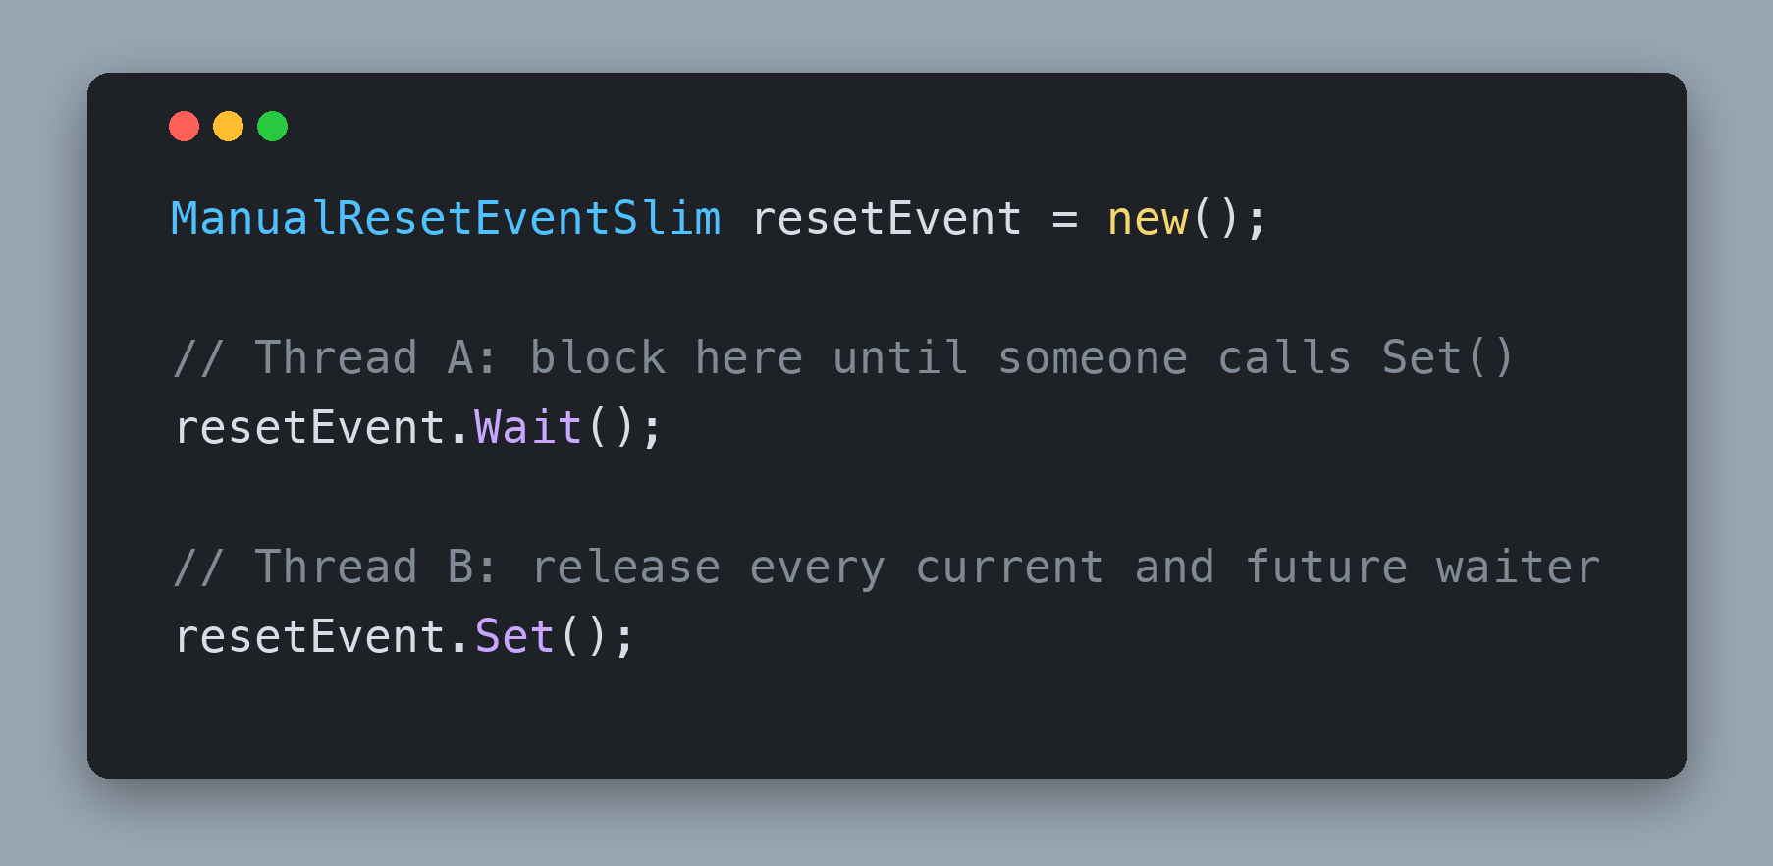
Blocking Waits
ManualResetEventSlim
`Wait()` blocks until `Set()` is called
Once set, every current and future waiter passes
Register `Set()` as a continuation, then block
After waking, rethrow the stored `Exception`
Notes:
Wait() blocks the calling thread until the task completes. We spent this morning telling you never to block, and the reason stands: a blocked thread is wasted, and blocking a thread that owns a SynchronizationContext deadlocks. The challenge asks for it anyway, for two reasons. The awaiter's GetResult() needs a synchronous way to observe the outcome, and Task.Wait() exists, so you should know how it is built.
Bullet by bullet:
• Wait() blocks until Set() is called: ManualResetEventSlim is the primitive. Wait() parks the calling thread until another thread calls Set().
• Once set, every current and future waiter passes: it is a gate, not a ticket. It stays open until someone calls Reset(), which you never will here.
• Register Set() as a continuation, then block: reuse the machinery you already built. Only create the event when the task is still incomplete, and register its Set() as a continuation while you hold the lock so the check and the registration are atomic. Calling ContinueWith() from inside your lock is fine: the lock statement, Monitor and the .NET 9 Lock type are all reentrant, so the same thread can enter a lock it already holds. Because the event goes through the same continuation list as everything else, two callers blocking on one task each get their own event and both wake up.
• After waking, rethrow the stored Exception: with ExceptionDispatchInfo.Throw(), so the caller sees the original stack trace.
The real Task does the same thing. Task.Wait() spins briefly, then registers a SetOnInvokeMres continuation, a ManualResetEventSlim subclass whose Invoke() calls Set(), and blocks on it. Search Task.cs for SpinThenBlockingWait.
Why this matters for the challenge: requirement 8, Wait() with a blocking wait primitive, and it is also how the provided CustomTaskAwaiter.GetResult() observes the outcome.
References:
https://learn.microsoft.com/dotnet/api/system.threading.manualreseteventslim
https://github.com/dotnet/runtime/blob/main/src/libraries/System.Private.CoreLib/src/System/Threading/Tasks/Task.cs

Slide 11
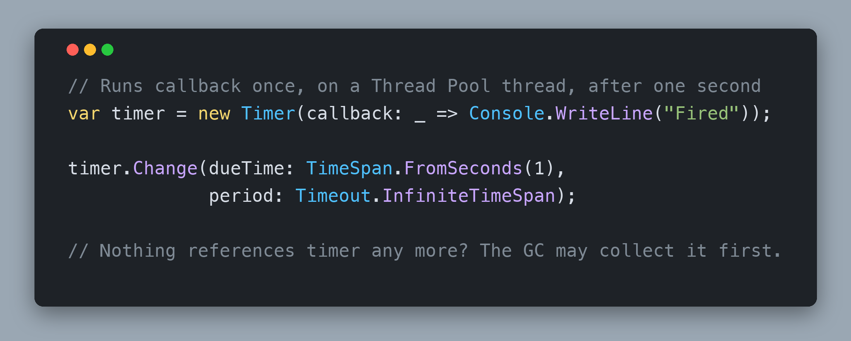
Timers
System.Threading.Timer
Callback runs on a Thread Pool thread
`Change(dueTime, Timeout.InfiniteTimeSpan)`: fire once
No live reference? The GC can collect it before it fires
`Dispose()` it from inside the callback
Notes:
Delay(TimeSpan) returns a task that completes when a timer fires. No thread waits; that is the whole point of Task.Delay() over Thread.Sleep().
Bullet by bullet:
• Callback runs on a Thread Pool thread: System.Threading.Timer, not the Windows Forms or System.Timers one. Its callback is queued to the pool when the due time elapses, so the thread Id printed after a Delay() is another pool thread.
• Change(dueTime, Timeout.InfiniteTimeSpan): fire once: dueTime is the delay before the first callback, period is the repeat interval. Timeout.InfiniteTimeSpan as the period means never repeat.
• No live reference? The GC can collect it before it fires: this is the bug that costs the most time. A Timer is an ordinary managed object, and the documentation says it plainly: a Timer is subject to garbage collection when there are no references to it, and the fact that it is still active does not prevent that. Your Delay() method creates the timer and returns, so ask yourself what is still referencing it while it waits. One answer is to give the callback itself a reference to the timer, which means declaring the variable before you assign it.
• Dispose() it from inside the callback: once a one-shot timer has fired it is done. Disposing it inside the callback releases its slot in the runtime's timer queue and makes the lifetime obvious to the next reader.
Task.Delay() is implemented the same way: DelayPromise in Task.cs is a Task that owns a TimerQueueTimer and completes itself when it fires.
Why this matters for the challenge: requirement 9 says it directly: use Timer, keep it alive until it fires, dispose it from the callback. Program.cs awaits Delay() twice, and if the timer is collected early those awaits never resume and the program sits there silently.
References:
https://learn.microsoft.com/dotnet/api/system.threading.timer
https://github.com/dotnet/runtime/blob/main/src/libraries/System.Private.CoreLib/src/System/Threading/Timer.cs

Slide 12
Await Uses Duck Typing
Any Type With GetAwaiter() Can Be Awaited
If it walks like a duck and it quacks like a duck, then it must be a duck.
Notes:
This is the whole point of the section. The await keyword is not tied to Task. It is tied to a pattern of a few members, and any type that provides them can be awaited.
The C# compiler does not check for a base class or an interface on the awaited expression. It looks for a method called GetAwaiter(), and then it looks at what that method returns. That means the C# language feature and the .NET library type are independent. The language team defined the pattern so the runtime team, and you, could plug in whatever completion object made sense. Task happened to be the first and most common implementation, which is why people conflate the two.
It also means every async/await behaviour you have ever debugged, thread switches, context capture, exceptions surfacing at the await instead of where they were thrown, lives in the awaiter and the task, not in the keyword. If you take one idea home from today, take this one.
Why this matters for the challenge: because the starter's CustomTask already declares GetAwaiter(), the top-level await statements in Program.cs compile from the start with no changes to the compiler, no attributes and no registration. They start working the moment your GetAwaiter() returns a real CustomTaskAwaiter.
References:
https://learn.microsoft.com/dotnet/csharp/language-reference/operators/await

Slide 13
Let's Build a Task
Notes:
Time to switch from listening to typing.
Before you open the IDE, say back to yourself what a Task is: a completion flag, a stored exception, a list of continuations, and a lock around all three. Everything you are about to write is a method that reads or writes that state.
Build up to it in stages. The starter builds from the first minute, because every public member is already a stub, but running it stops at the first stub you have not replaced yet. Start with the fields and the shared completion method. Add ContinueWith(), because Wait() and the awaiter both register through it. Then Wait(), then Run(), then Delay(), then GetAwaiter(). At that point no stubs remain, and Program.cs runs all five steps as written.
Test as you go, in temporary code at the bottom of Program.cs that you delete before comparing with 2. Finish. Chain two ContinueWith() calls, then Wait() on the task the second one returned; if that Wait() never returns, the returned task is never being completed. For two waiters, and for the several-thousand-link chain, build the chain on top of CustomTask.Delay(TimeSpan.FromSeconds(1)) so nothing has completed while you are still registering. Starting from an already completed task makes the test depend on how fast the pool drains the chain behind you, and a stack overflow you cannot reproduce is worse than one you can.
Use the .NET source when you get stuck. Task.cs and TaskAwaiter.cs are the reference implementation of what you are building, and the System.Runtime.ExceptionServices using at the top of the starter CustomTask.cs is a hint.
References:
https://github.com/dotnet/runtime/blob/main/src/libraries/System.Private.CoreLib/src/System/Threading/Tasks/Task.cs
https://github.com/dotnet/runtime/blob/main/src/libraries/System.Private.CoreLib/src/System/Runtime/CompilerServices/TaskAwaiter.cs

Slide 14
Challenge: Build an Awaitable CustomTask
CreatingTaskFromScratch, 45 minutes
Build `CustomTask` in 45 minutes
  Provided: `CustomTaskAwaiter.cs`, `Program.cs`, `CustomTask` stubs
  `Program.cs` runs all five steps, as its comments describe
  Chained `ContinueWith()` never hangs, two waiters both resume
  Several thousand links, no stack overflow
AI Agents: understand, interpret errors, ask questions
    Not to solve the challenge. You're smart. You got this.
Notes:
Forty-five minutes, with the afternoon break in the middle. Open 4. Creating Custom Implementation of Task/1. Start/CreatingTaskFromScratch.slnx and run it once. It builds, but it stops at the first NotImplementedException, and that is expected: every public member of CustomTask is already a stub, and each stub's message is a hint about what that member needs to do.
Two files are already finished. CustomTaskAwaiter.cs is the bridge from the previous slides; read it, do not edit it. Program.cs already calls every public member of CustomTask in five numbered steps, and its comments explain what each member should do. Use it as your guide: it is what you are building towards, so finish with it exactly as you found it. Temporary test code at the bottom of it while you work is fine and expected; delete it before you compare with 2. Finish. Everything else you write goes in CustomTask.cs.
You are building Run(Action), ContinueWith(Action), Wait(), Delay(TimeSpan), IsCompleted, SetResult(), SetException() and GetAwaiter(), plus the completion state underneath them: a lock, a completed flag, a stored exception, and a list of continuations with their captured ExecutionContext.
You are done when the solution builds and Program.cs runs all five steps with the output its comments describe, a continuation runs after the first task completes, chaining ContinueWith() on the task returned by ContinueWith() does not wait forever, two callers waiting on the same incomplete task both resume, and a chain of several thousand ContinueWith() calls finishes without a stack overflow.
Use AI Agents to understand the existing code, clarify task-like type concepts, interpret errors and ask questions. Please do not let them solve the challenge. You're smart. You got this. We review approaches as a group before opening SOLUTION.md together and comparing with 2. Finish.

